Slide 1
translationRecorder v1.2.4
Recording from project manager
Oral Languages

Slide 2
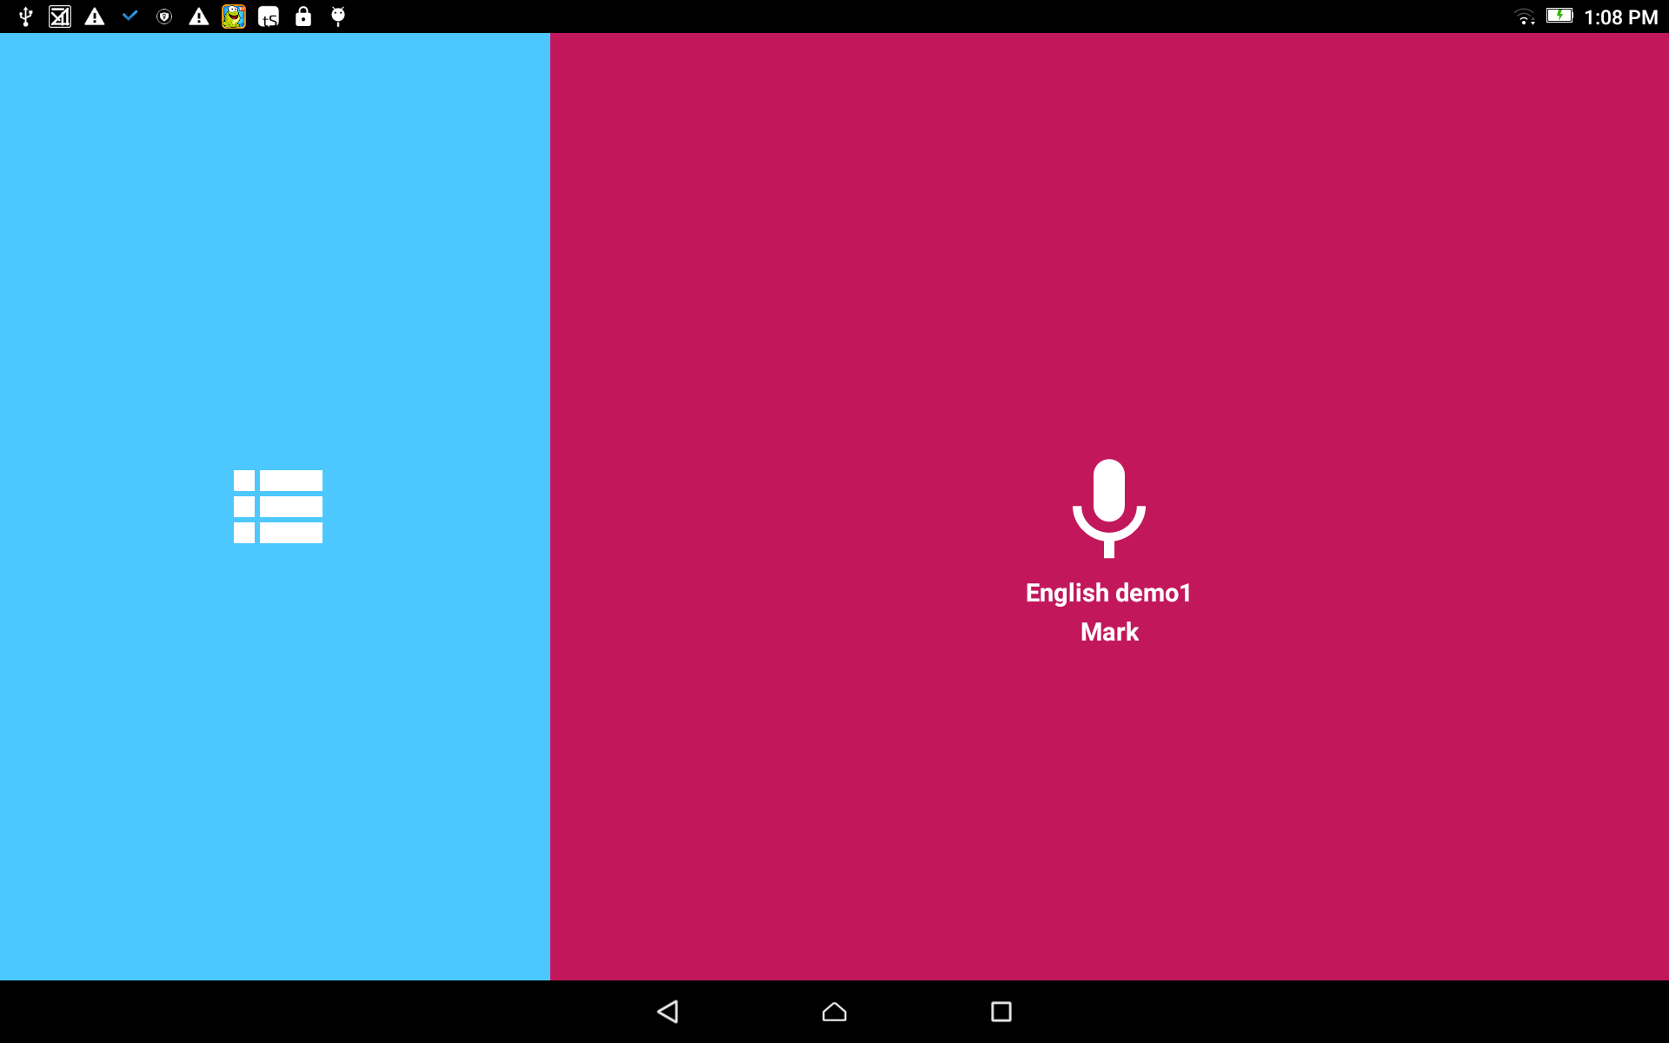
Recording (from Project Manager):
From the home screen, tap in the blue area to open the Project Manager.
This step is for when the user returns to a recording session

Slide 3
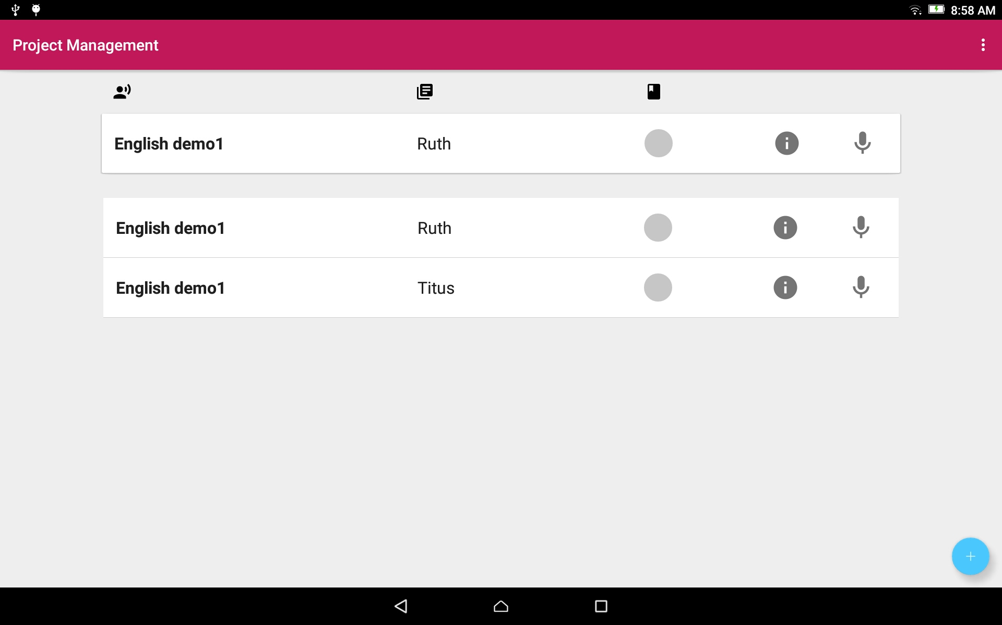
Project Manager:
Tap on the project bar to open the project.
At the top of the list is the project that was worked on last.
These projects are the same project. They are listed 2 times.

Slide 4
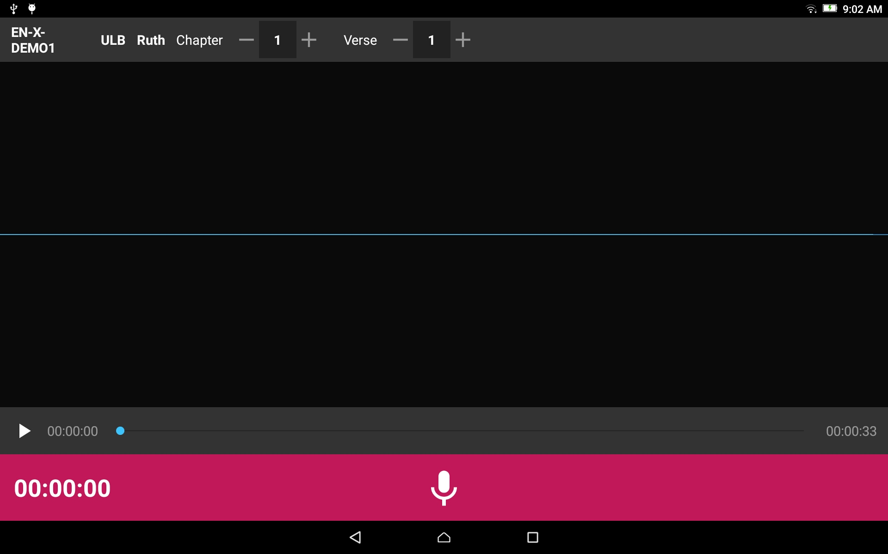
The Project Opens:

Slide 5

Recording:
Check the information on the top gray bar:
Target Language
Project Type
Book
Chapter
Verse or Chunk

Slide 6
Recording:
Check the information on the top gray bar:
Choose the plus and minus signs to change the numbers.

Slide 7

Recording:
Listen to the Source Audio
Tap on the play Source Audio icon.
Listen to the source audio.

Slide 8
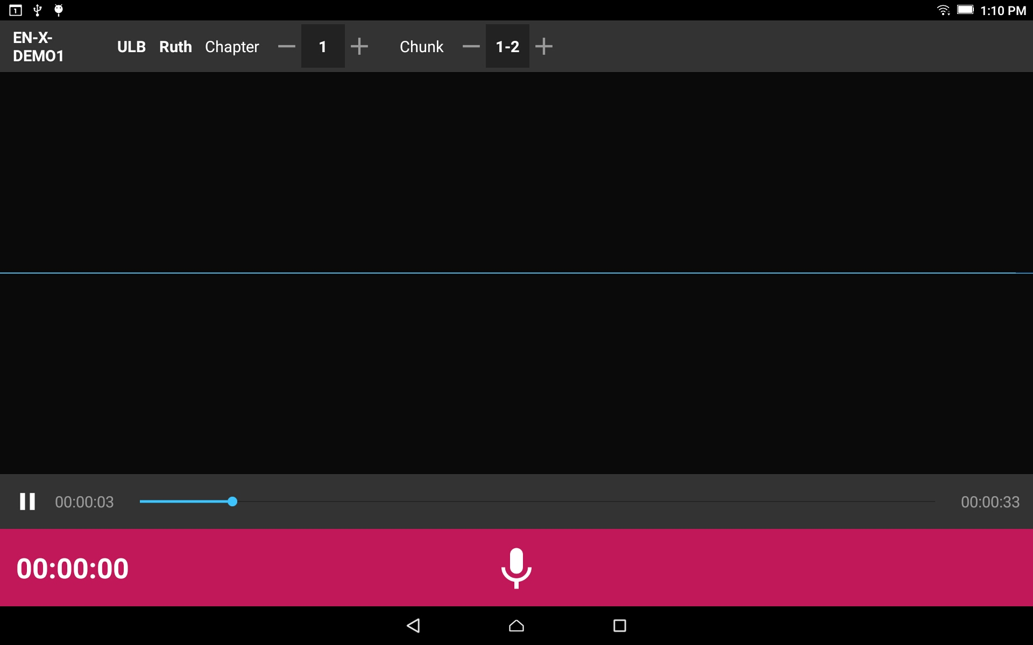
Recording:
Listen to the Source Audio
Tap on the 2-vertical lines to pause the audio.
Tap-hold-drag the blue dot to go to another place in the audio.

Slide 9
Recording:
Ready to record the translation?
Tap on the microphone icon on the pink bar.

Slide 10
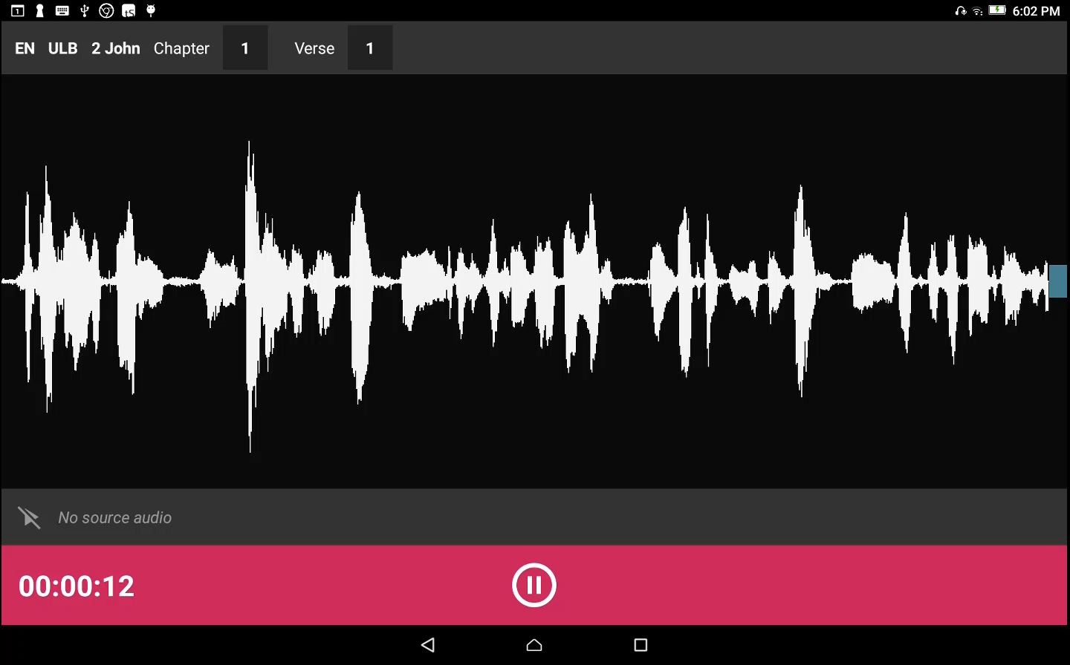
Recording:
As you begin to speak you will see waves appear on the screen which is a result of the sound of your voice.

Slide 11
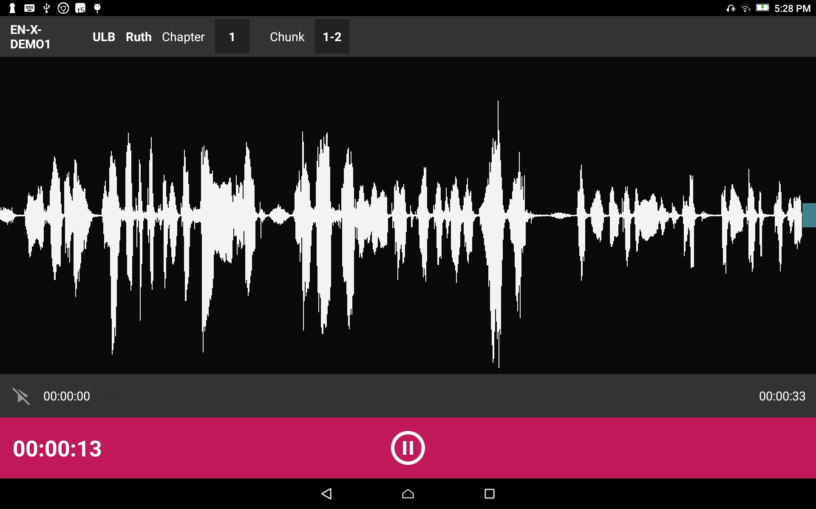
Recording:
When done with that portion, tap the pause button.
Optional - Tap on the microphone icon to start recording again.

Slide 12
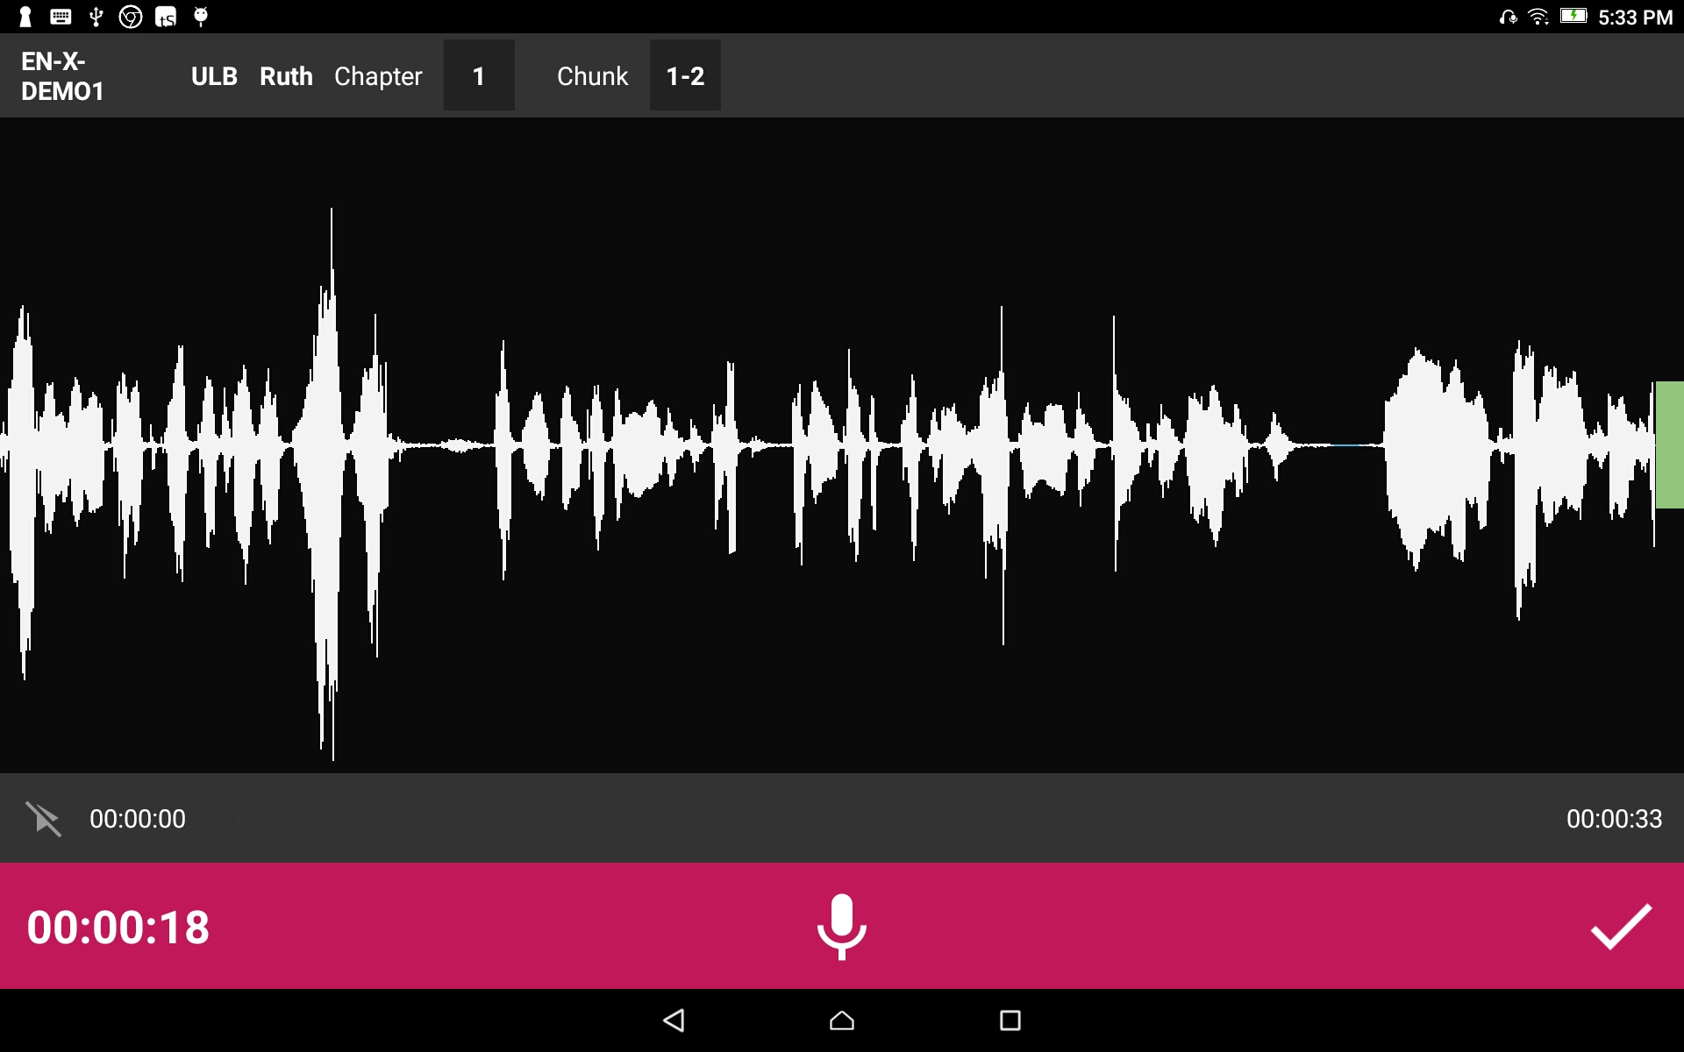
Recording:
Tap the checkmark to save the recording.

